Slide 1


Using Filter Banks in Convolutional Neural Networks for Texture Classification
Cyber-Physical Systems & Artificial Intelligence Lab
Article published in Pattern Recognition Letters. DOI: 10.1016/j.patrec.2016.08.016
V. Andrearczyk & Paul F.Whelan
Jang Cheolweon
Cyber-Physical Systems &
Artificial Intelligence Lab
2019. 04. 06
Notes:
I will start my presentation. The paper I'm going to introduce to you today is Using Filter Banks in Convolutional Neural Networks for Texture Classification. It was published in Pattern Recognition Letters, journal of Q1 quality, in 2016.

Slide 2
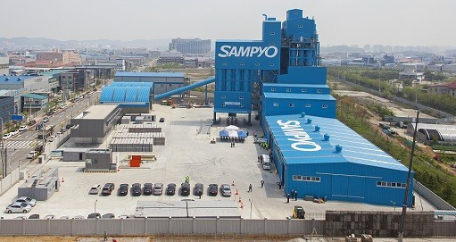
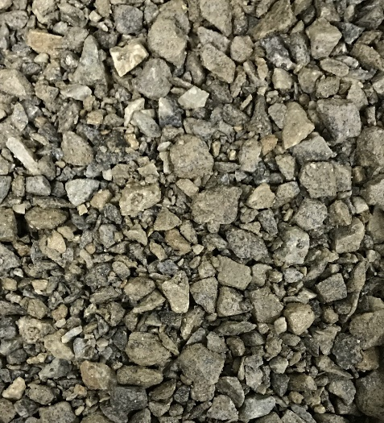
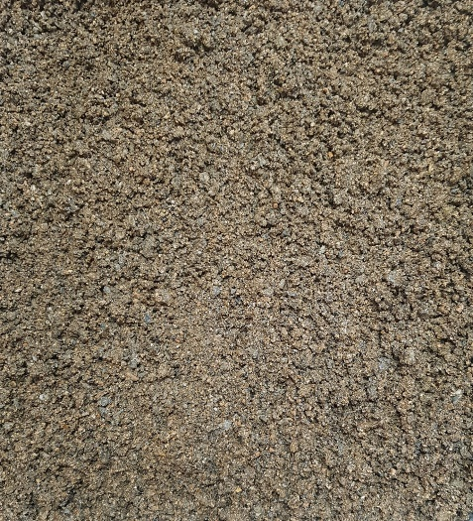
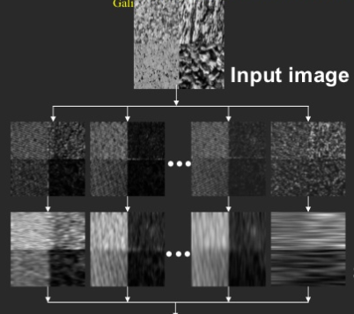
reasons
Cyber-Physical Systems & Artificial Intelligence Lab
No Advance Research
Requires applicable research
in other fields
Texture Analysis
A field that has been continuously studied
since the 90s
Notes:
There was a reason. In performing the sampyo project, there was no advance research. So I required applicable research in other fields. While searching for researchs, I found a field about the texture analysis. As you can see, the images for texture are similar to those of sampyo. This is a field that has been continuously studied since the 90s. So there are many advance research using Techniks from classical feature to deep-learning.

Slide 3
introduction
Cyber-Physical Systems & Artificial Intelligence Lab
Texture CNN
Main idea
The overall shape information extracted by classic CNN
is of minor importance in texture analysis
Develop a new energy layer that use classical fixed filter
and concatenate it in CNN model
Notes:
The main idea is very simple. It starts from think that the overall shape information extracted by the fully connected layers of a classic CNN is of minor importance in texture analysis. So the author is saying to have developed a new layer that use classical fixed feature and concatenate it in CNN model.

Slide 4
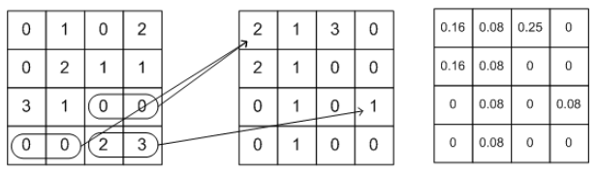

introduction
Cyber-Physical Systems & Artificial Intelligence Lab
Energy of Image
Co-occurrence Matrix
Method of representation of how many pairs of pixels
have appeared in one image.
Energy
Features that can measure the uniformity of brightness
Notes:
Before explain the energy layer, I have to explain the concept of co-occurrence matrix and energy in the image. Co-occurrence Matrix is a method of representation of how many pairs of pixels have appeared in one image. And this formula is the energy of that image.
Energy is Features that can measure the uniformity of brightness. For example, lf there is no change in brightness between each pixel in the picture, The energy has large value.

Slide 5
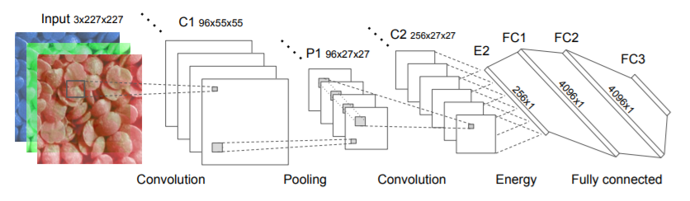
Method description
Cyber-Physical Systems & Artificial Intelligence Lab
Energy layer
Generates one value per feature map
Notes:
Now I’ll explain the energy layer. The energy layer is made by conversing the input image with the previously described energy-term and connecting it to the Fully connected layer.
in process from P1 to C2, Instead of training filter of CNN, it calculates a Co-occurrence Matrix. After this, As it move from C2 to E2, it Generates one value per feature map
, and is connected to the Fully connected layer.

Slide 6
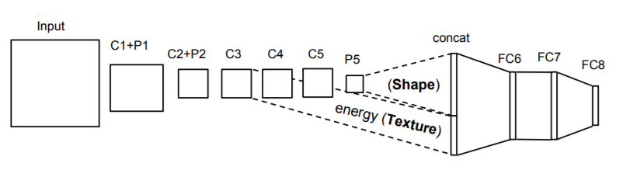
Method description
Cyber-Physical Systems & Artificial Intelligence Lab
T - CNN
Based on AlexNet
Divide T-CNN-1 to 5 depending on when Energy layer is created
Keep the computation time and memory consumption close to the original AlexNet
Notes:
This texture CNN based on Alexnet. The input image is passed through a few layers and then the energy layer is created at some point. After this it merged into the Fully connected layer. Thay are divided from T-CNN-1 to 5 depending on when Energy layer is created. Because the energy layer was created from the middle,This Keep the computation time and memory consumption close to the original AlexNet.

Slide 7
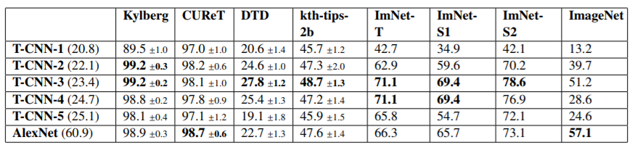
Result
Cyber-Physical Systems & Artificial Intelligence Lab
Performance
Notes:
This is result. This table compares Alexnet with Texture CNN. And as said previous slid, T-CNN divided into 5 type. As you see, T-CNN-3 show the best performance.

Slide 8
Conclusion
Cyber-Physical Systems & Artificial Intelligence Lab
The design of the T-CNN enables a simple and efficient integration into a classic CNN architecture
Keep the computation time and memory consumption close to the original AlexNet
Expecting effectiveness in applying to complex structures such as GoolgeNet instead of AlexNet
Expecting effectiveness in applying to Sampyo project
Notes:
the conclusion.

Slide 9
Conclusion
Cyber-Physical Systems & Artificial Intelligence Lab
I think it is a good paper because it use simple ideas and show good performance
I get know CNN can be merged with fixed filter
It was difficult to understand because there was no concept of Co-occurrence Matrix and energy of image
It contribute to field of texture analysis by proposing method merge with classic technique and deep-learning
Notes:
And finally, Pros and cons

Slide 10
Q&A
Cyber-Physical Systems & Artificial Intelligence Lab
Q&A
Q&A
Notes:
Energy는 명암도의 균일함을 측정할 수 있는 특징으로 서, 영상의 각 화소들 사이에 밝기 변화가 없다면 P[i, j]요소 값이 제한된 위치에 집중되어서 결과적으로 큰 값을 갖게 된다. 즉, 영상의 모든 화소가 같은 명암도 값 을 가질 때 Energy는 최고의 값을 가진다.

